Slide 1
Electronic Informed Consent Management System
Anna Poluektova
Natallia Isayenka

Slide 2
Main Objective
is to build a web application that would implement all consent management workflows including:
Patient management module;
Consent form template management module;
Informed Consent tracking module;
Search and reporting capabilities

Slide 3
Corporate Goals
Patient demographic information management
Consent form management
Fast and secure access to patient and consent information through search and reporting capabilities

Slide 4
Business Opportunity
Electronic Consent management is vital part of the patient enrolment process
Most of modern Clinical Trial Management System have Electronic Consent Management feature as the part of the system
Systems like that are intended to be used in regulated clinical trials and it significantly increase the license cost and total cost of the ownership

Slide 5
Business Opportunity
Non-commercial institutions such as university research teams who are conducting non-regulated trials and have limited budgets may not be able to afford those systems
This system is intended to fill that gap and provide robust cost effective solution to manage patients/subjects consents

Slide 6
Problem Statement
Electronic Informed Consent Management System aims to improve and organize the process of:
capturing
reasoning
integrating
sharing consent permissions provided by patients for reusing clinical data and samples for research
The Corporate Goals will be resolved

Slide 7
Gantt Chart

Slide 8
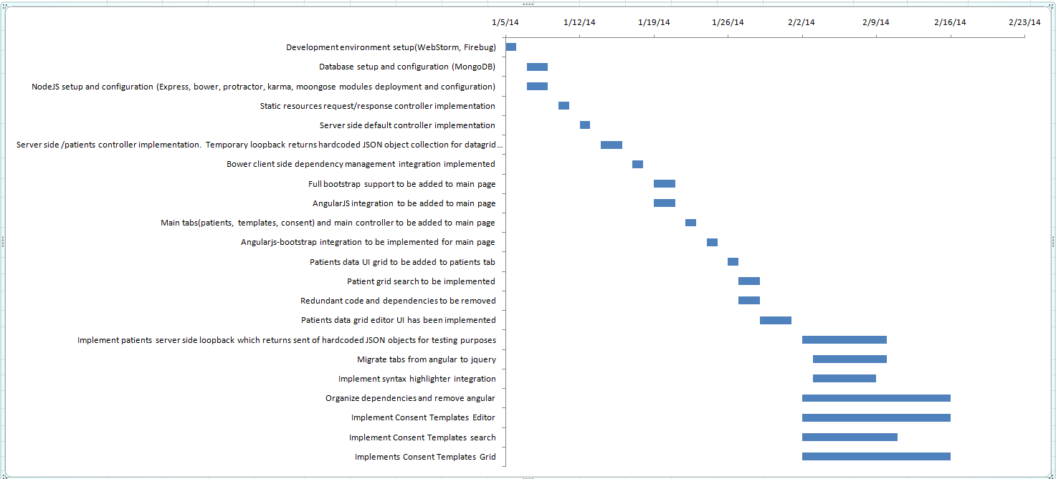
Gantt Chart

Slide 9
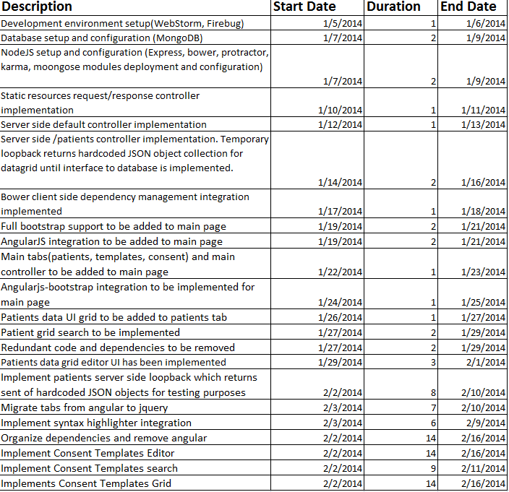
Tasks

Slide 10
Development environment setup
JetBrains WebStorm is a commercial IDE for JavaScript, CSS & HTML built on JetBrains' IntelliJ IDEA platform
It is a specialized version of PhpStorm, offering a subset of its features
It ships with pre-installed JavaScript plugins (such as for Node.js)

Slide 11
Development environment setup
Firebug is a free and open-source web browser extension for Mozilla Firefox that facilitates the live debugging, editing, and monitoring of any website's CSS, HTML, DOM, and JavaScript
It is a useful tool for web security testing and web page performance analysis

Slide 12
Database setup and configuration
MongoDB is a cross-platform document-oriented database
It is classified as a NoSQL database
It eschews the traditional table-based relational database structure in favor of JSON-like documents with dynamic schemas
It makes the integration of data in certain types of applications easier and faster

Slide 13
NodeJS setup and configuration
Node.js is an open source, cross-platform runtime environment for server-side and networking applications
Node.js applications are written in JavaScript, and can be run within the Node.js runtime on OS X, Microsoft Windows and Linux
It uses the Google V8 JavaScript engine to execute code, and a large percentage of the basic modules are written in JavaScript.

Slide 14
NodeJS setup and configuration
Express is a minimal and flexible Node.js web application framework that provides a robust set of features for web and mobile applications
Bower is a package manager for the web. Web sites are made of lots of things - frameworks, libraries, assets, utilities, and rainbows. IT manages all these things for you

Slide 15
Full bootstrap support to be added to main page
Added to main page bootstrap CSS to implement responsive layout for:
Datagrids
tabs
other UI components

Slide 16
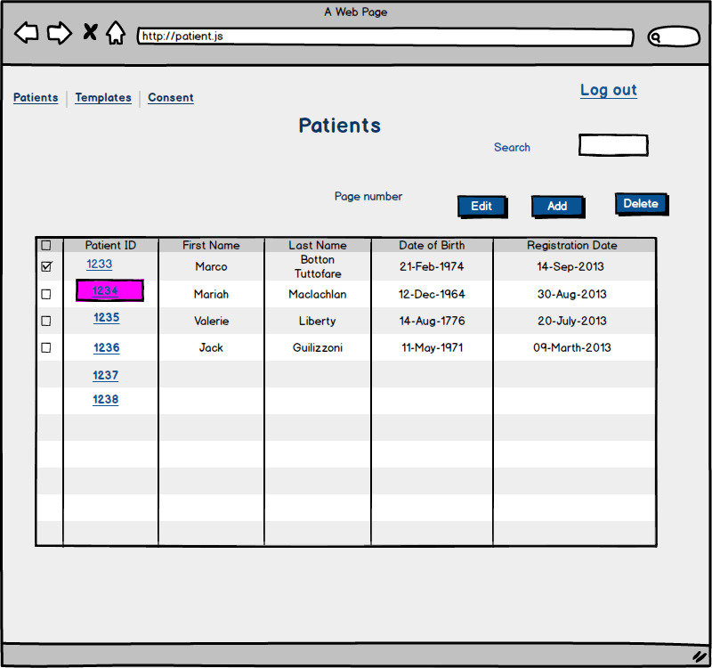
Patients data UI grid to be added to patients tab

Slide 17
Patients data grid editor UI implemented

Slide 18
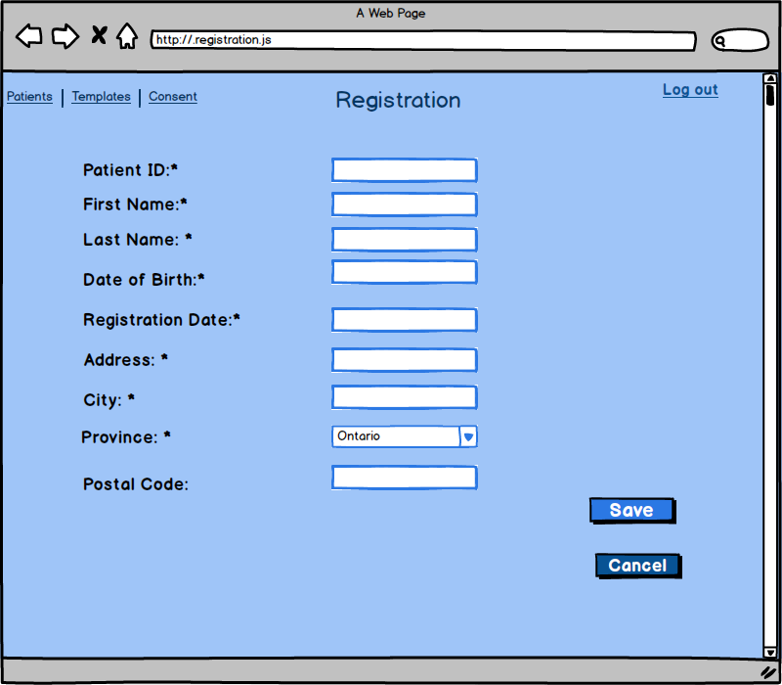
Add new patient

Slide 19
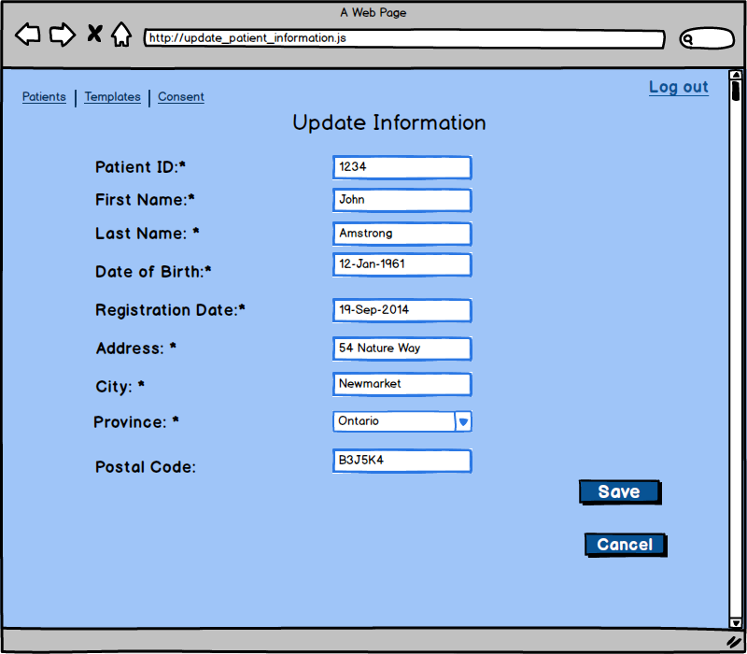
Edit patient

Slide 20
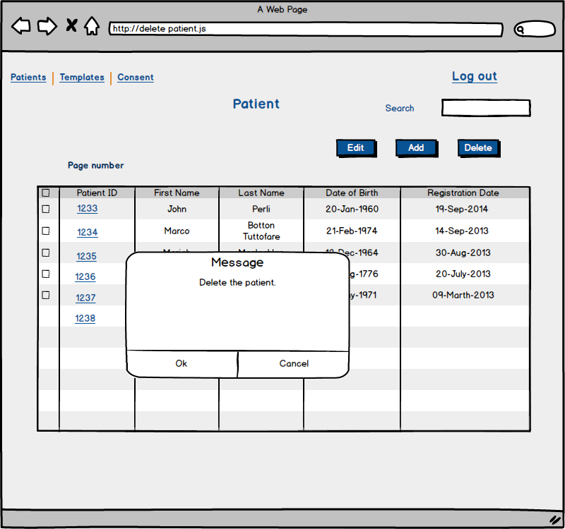
Delete patient

Slide 21
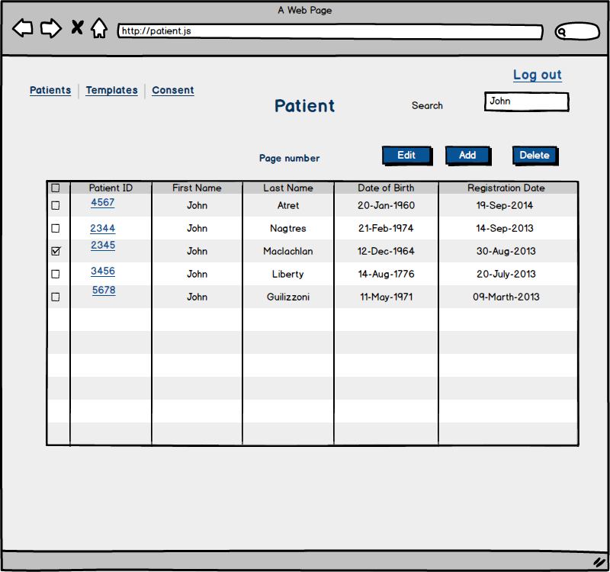
Patient grid search to be implemented

Slide 22
Implement patients server side loopback
Which returns sent of hardcoded JSON objects for testing purposes
This loopback is temporary code, which returns predefined json object. It allows to debug client side using real data set
It helps to separate server side and client do one thing at the time

Slide 23
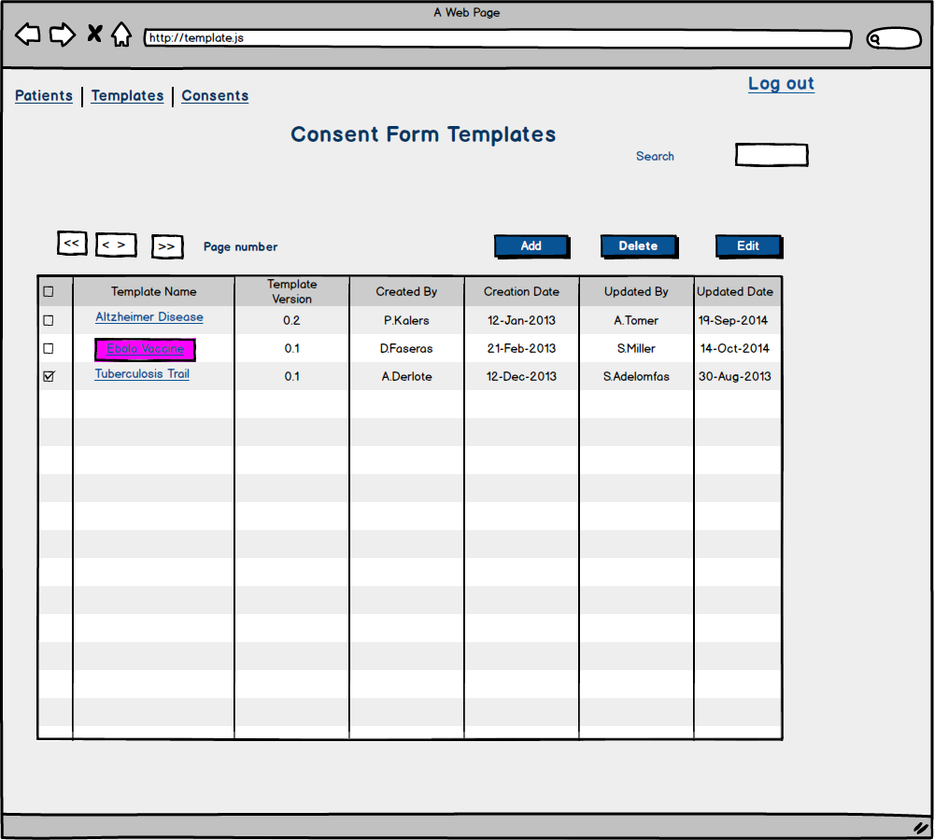
Implements Consent Templates Grid

Slide 24
Implement Consent Templates Editor
Displayed as three buttons on the top of consent template grid such as New, Edit, Delete

Slide 25
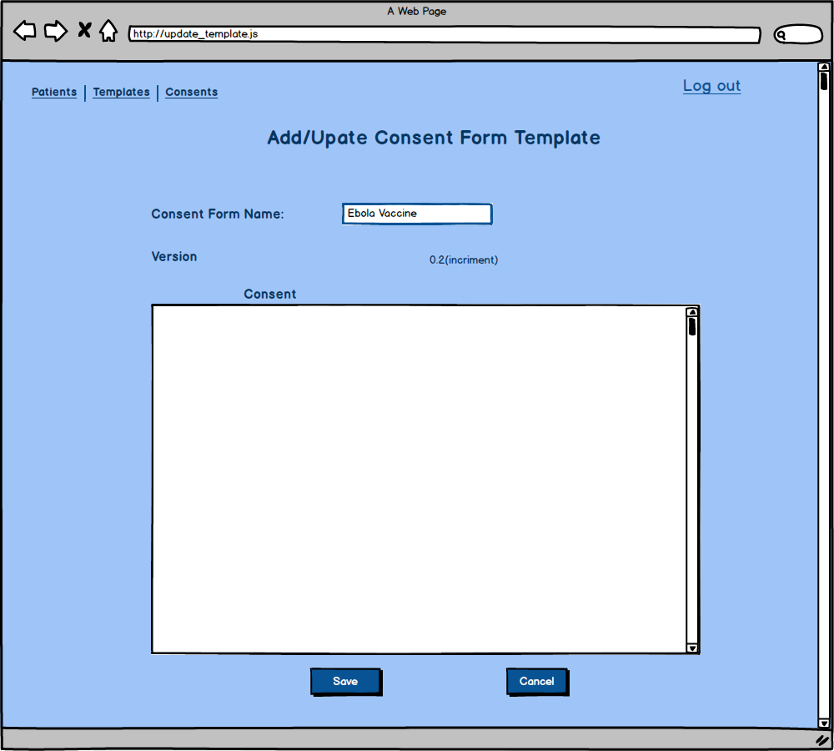
Edit template

Slide 26
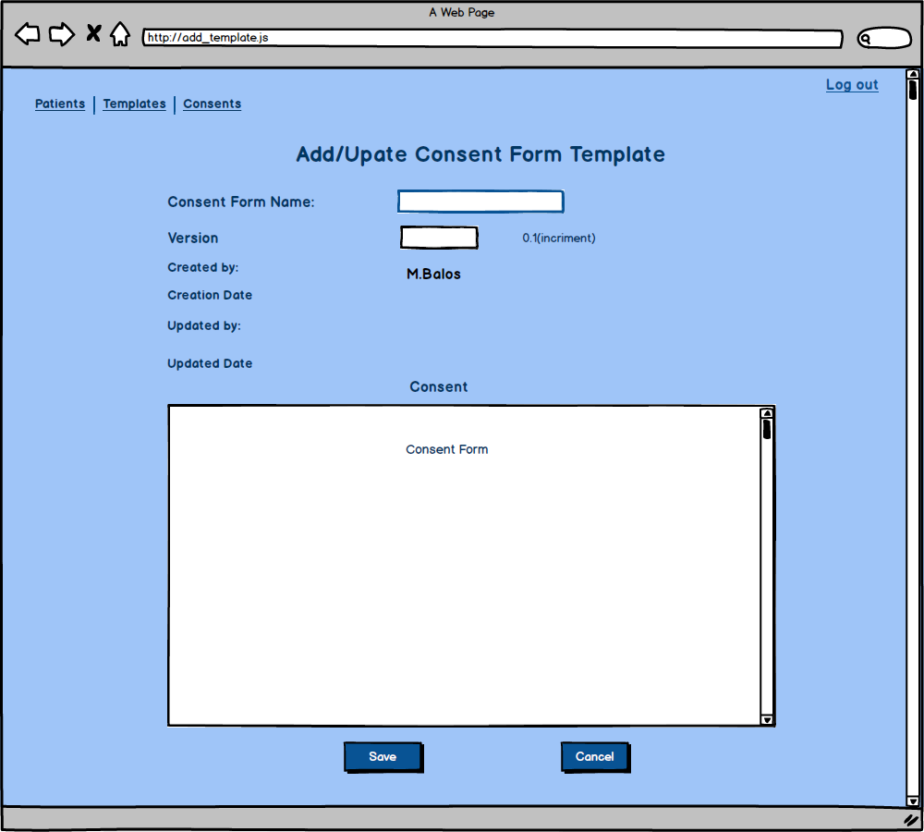
Add new templates

Slide 27
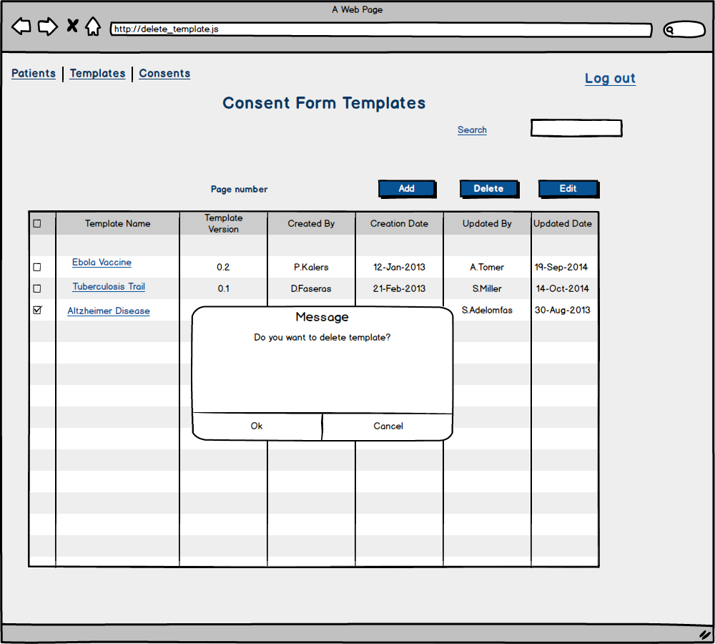
Delete template

Slide 28
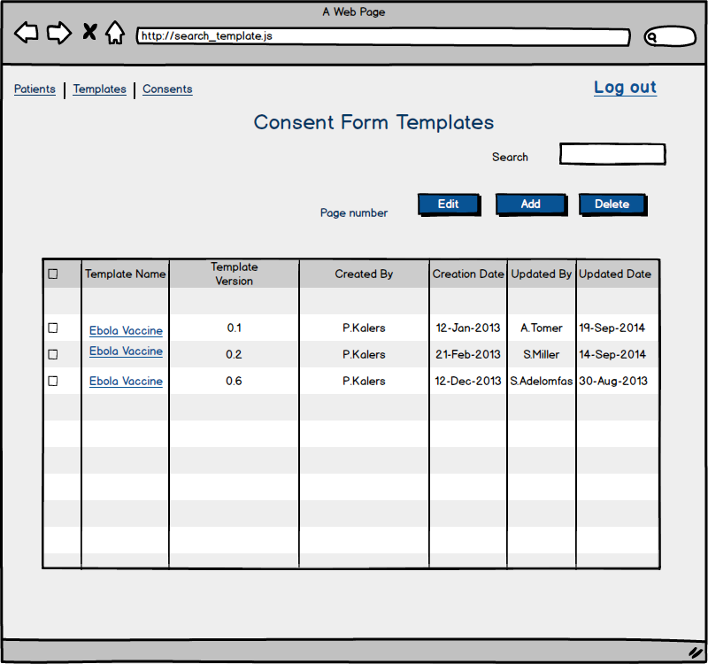
Implement Consent Templates search

Slide 29
Security
Use passport framework which provides seamless authentication to number of back-end
Like twitter, Facebook, LDAP, local database. Additionally used passport-local, which is passport implementation for local database as a back
and passport-local-mongoose which is the plugin which use MongoDb as the local MongoDb database as credentials and roles storage
Notes:
Jquery JqueryUI
Use passport framework which provides seamless authentication to number of back-ends like twitter, facebook, LDAP, local database. Additionally to passport, I used passport-local, which is passport implementation for local database as a back and and passport-local-mongoose which is the plugin which use mongodb as the local mongodb database as credentials and roles storage.

Slide 30
Issues and Resolution
Integration between JQuery and AngularJS is not always straightforward especially because of missing support of JQuery plugins for plugins in angular | Gradually implement missing parts, use wrappers where possible and leave JQuery as is when wrappers are impractical or impossible We have found instability and unjustified complexity when we were prototyping integration between Angular and JQuery-UI plugins especially in cases when we needed to integrate plugins for JQuery-UI plugins such as Editable plugin for Datatablejquery plugin We decided to ride of AngularJS and implement UI based on JQuery

